Slide 1


IESTI01 - TinyML
The Machine Learning
Paradigm
Prof. Marcelo Rovai
May 12th, 2021

Slide 2
The Machine Learning Paradigm From coding to learning…

Slide 3
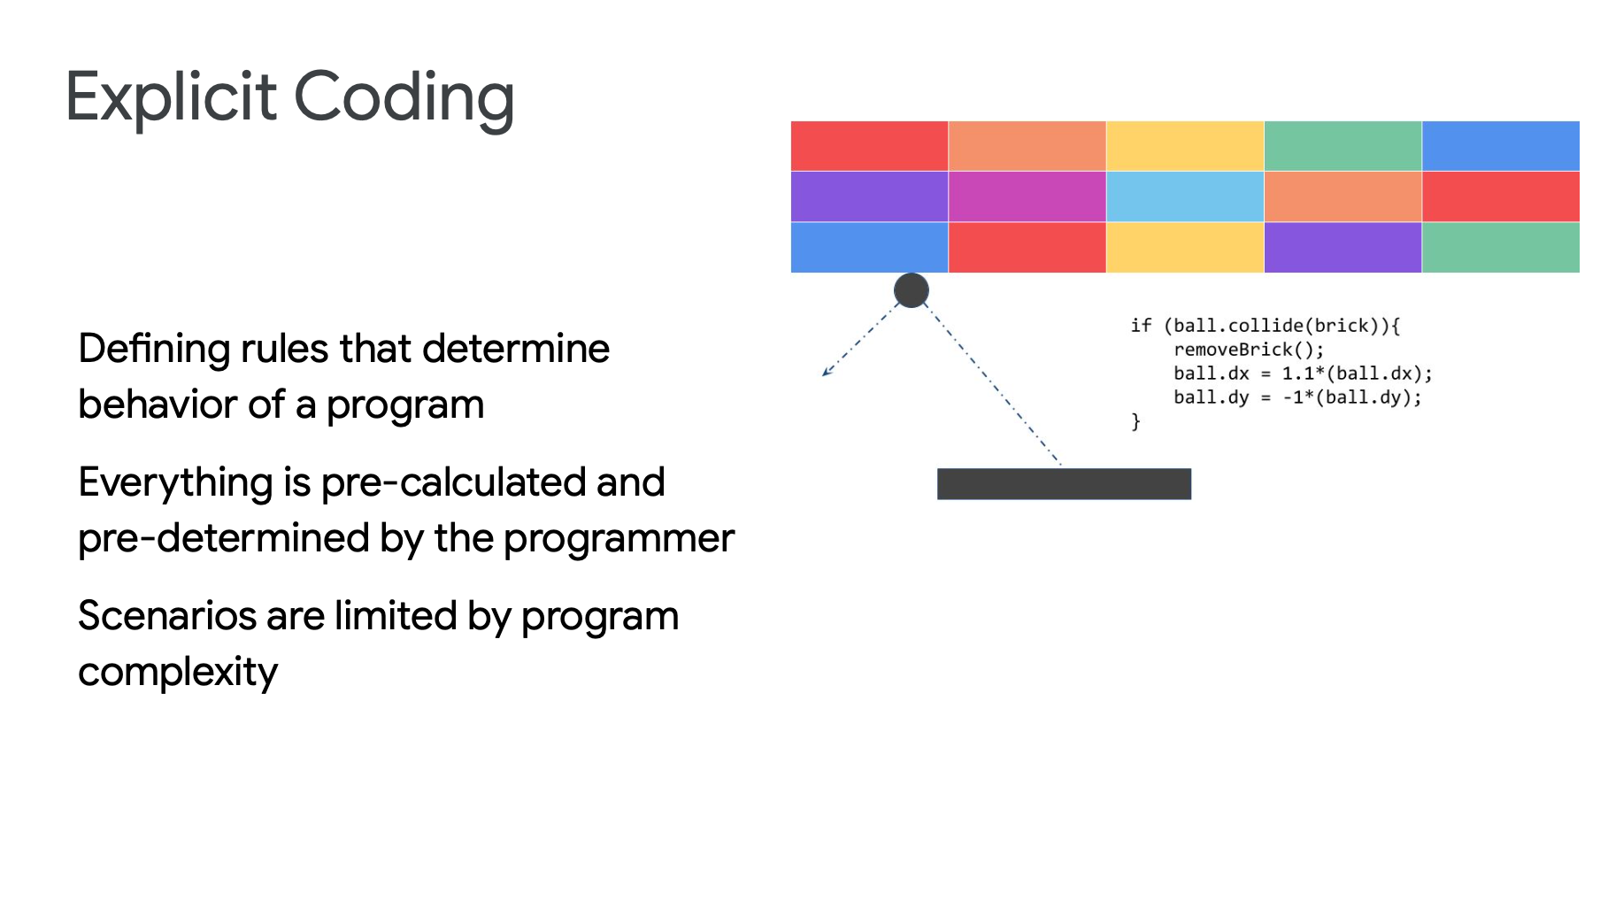

Slide 4
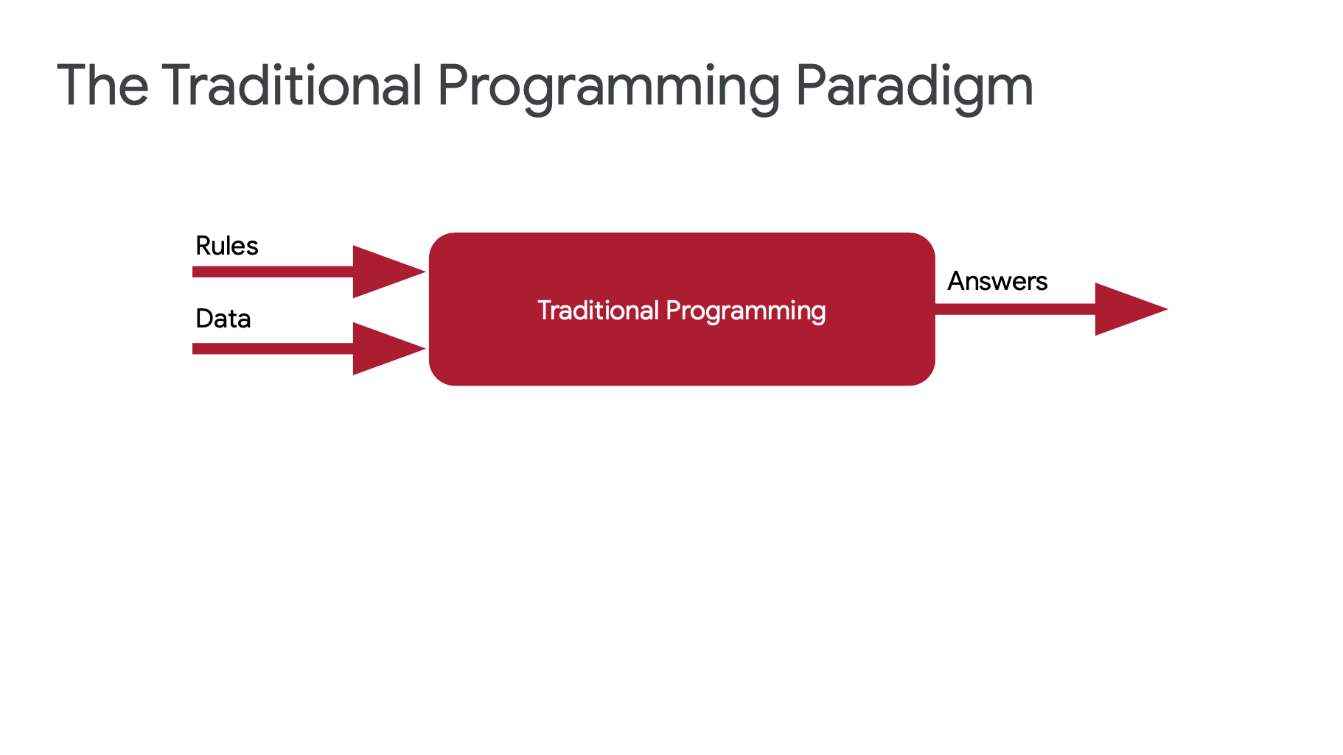

Slide 5
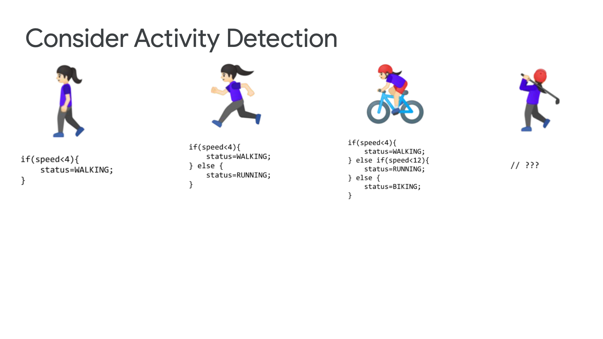

Slide 7
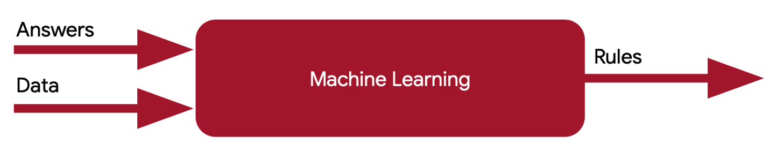

Slide 8
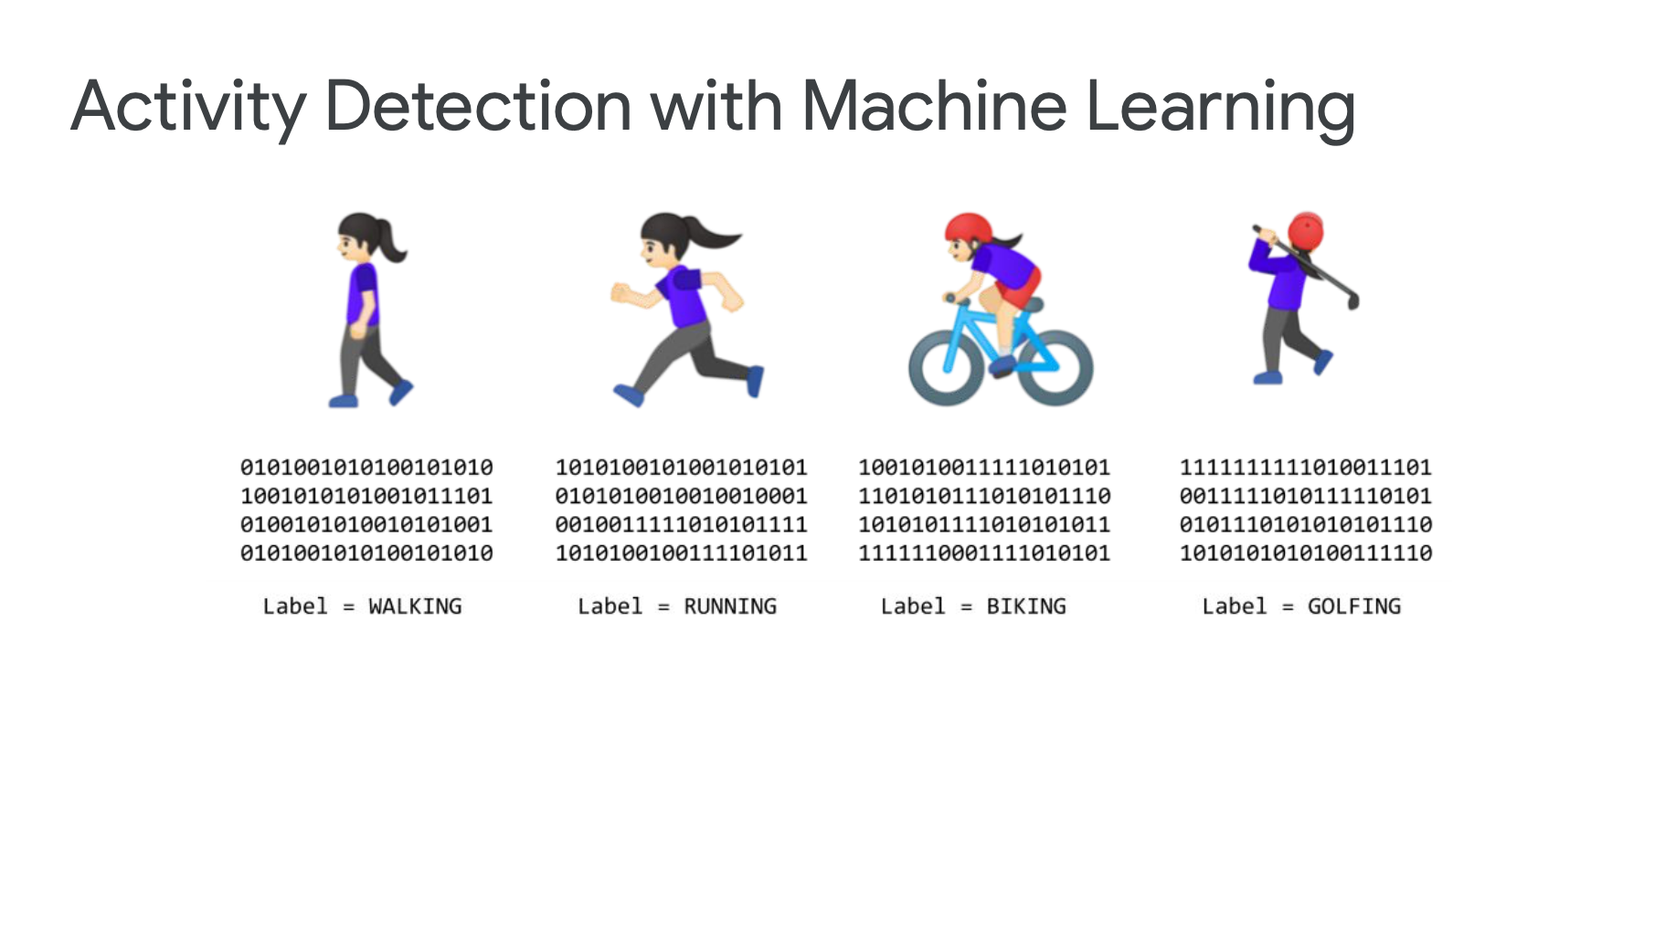

Slide 9
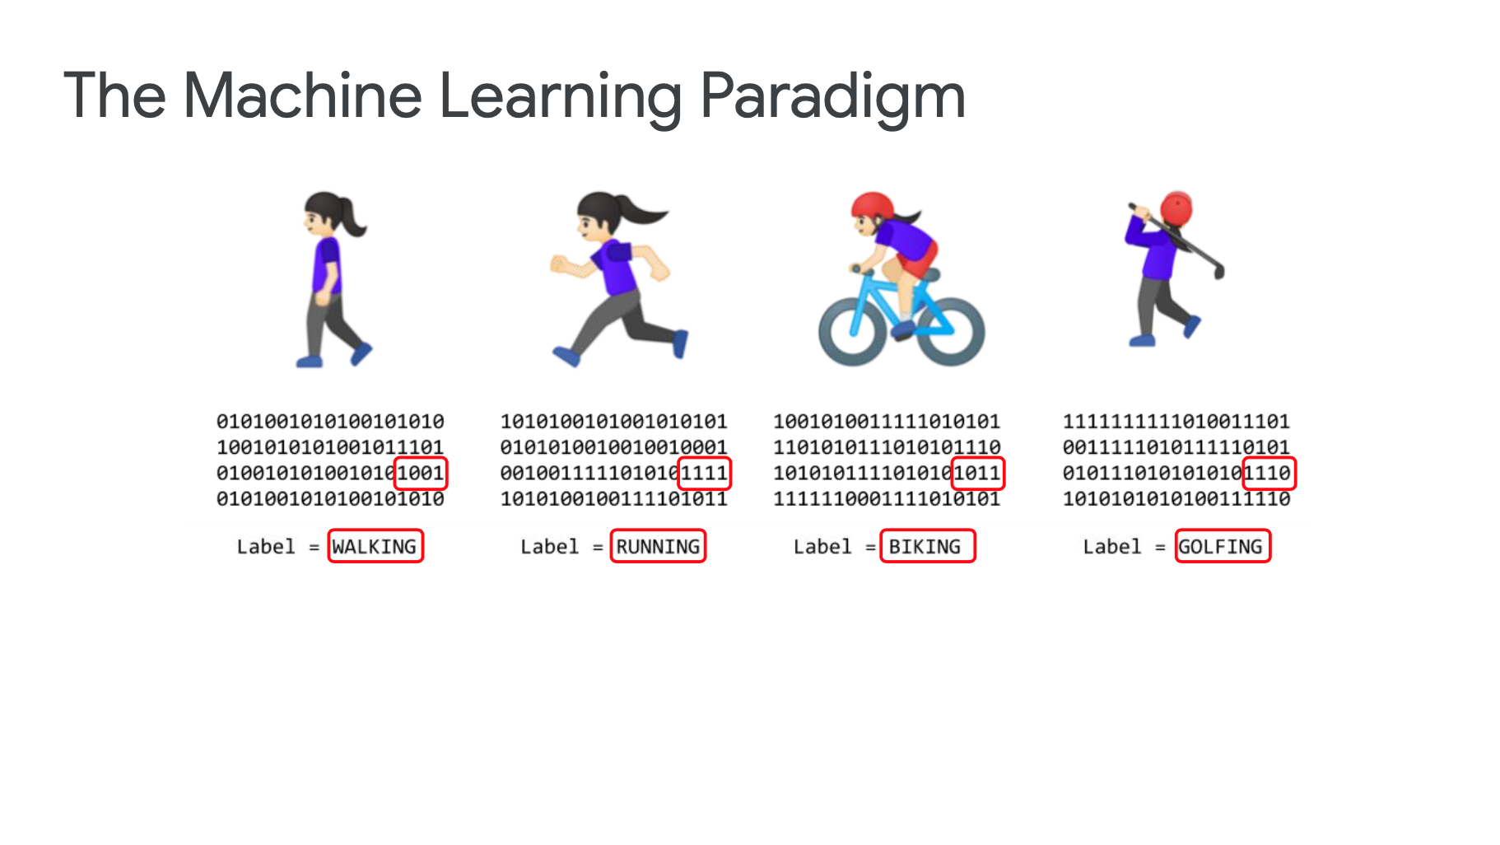

Slide 10
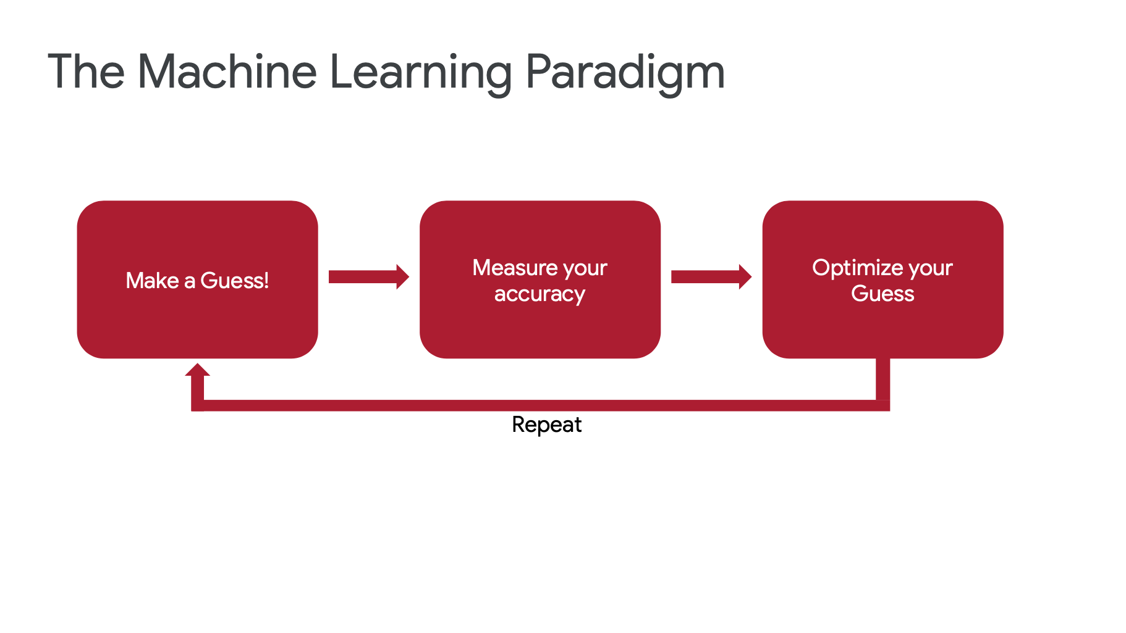

Slide 11
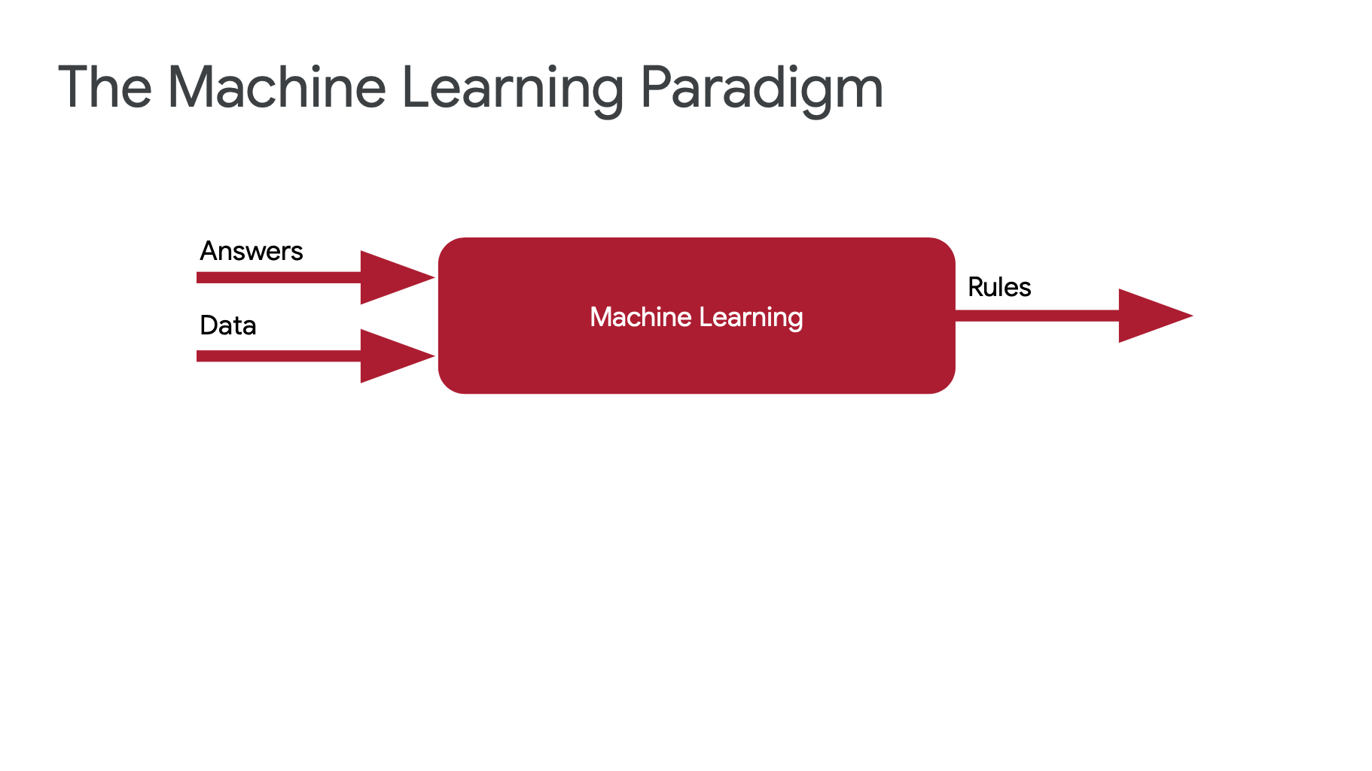

Slide 12
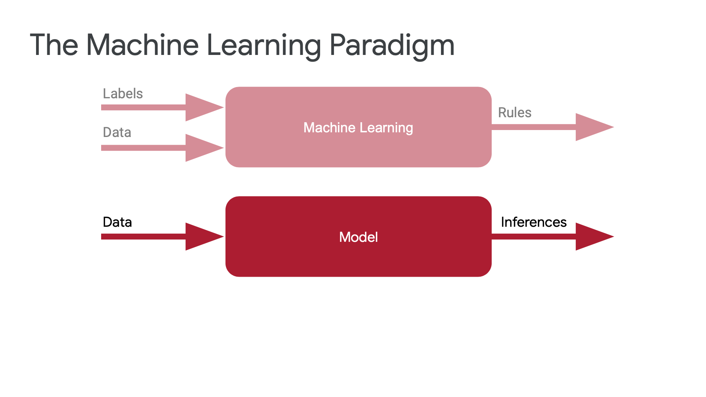

Slide 14
Thinking about loss… A way to measure your accuracy

Slide 15
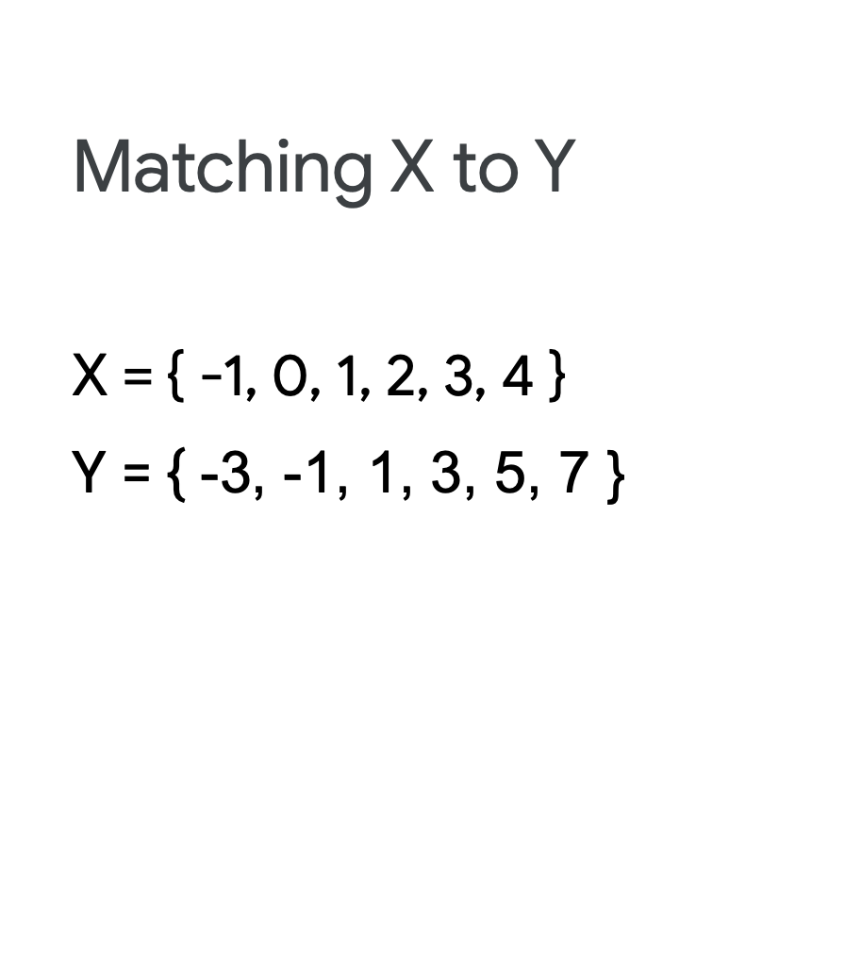
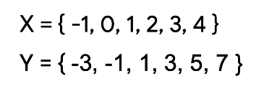

Slide 16
Y = p*X + b

Slide 17
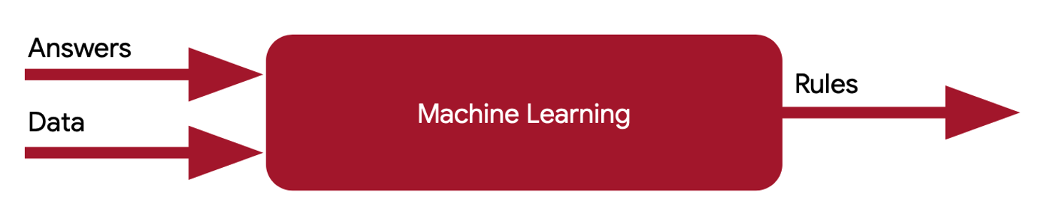
Y = p*X + b
Y
p, b
X

Slide 18
Input
Y = p*X + b
Parameters
Target
Y
p, b
X

Slide 19
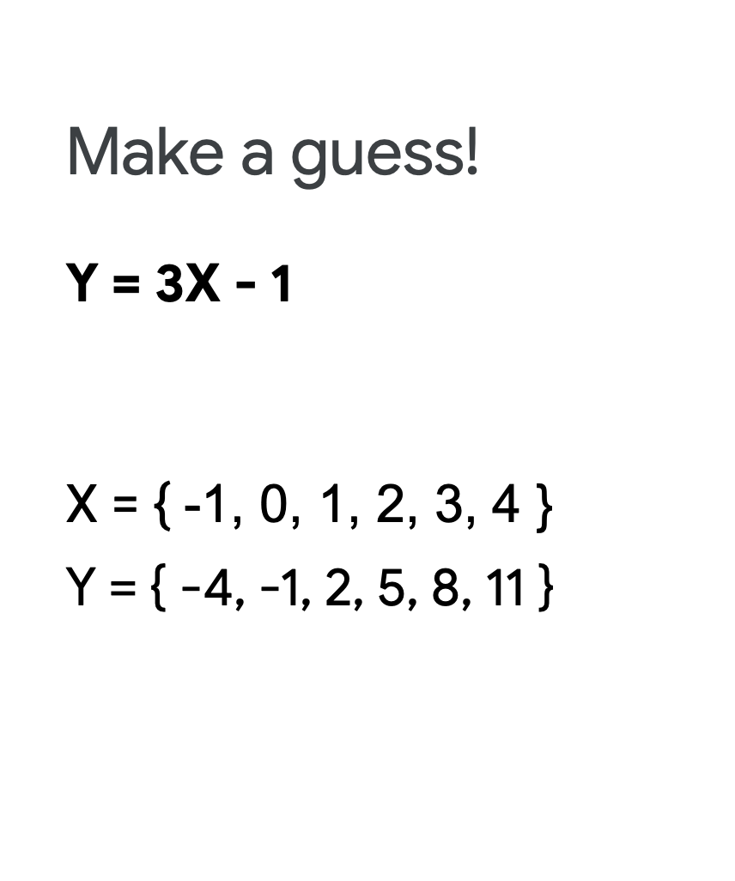

p = +3
b = -1

Slide 20
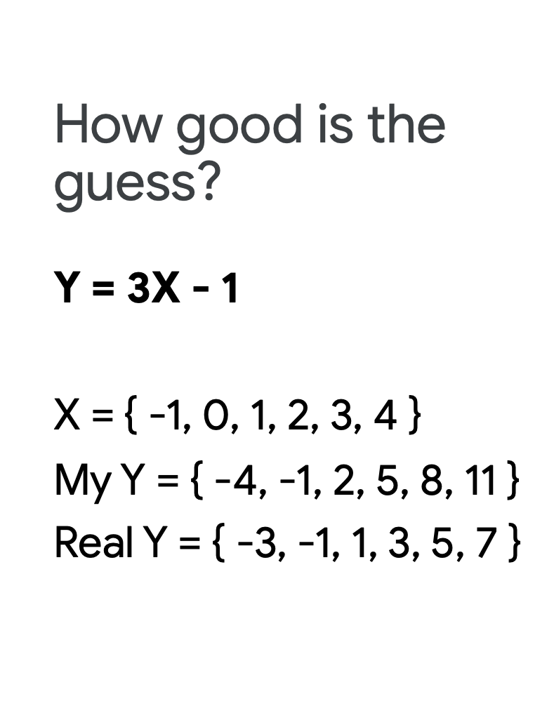

Slide 21
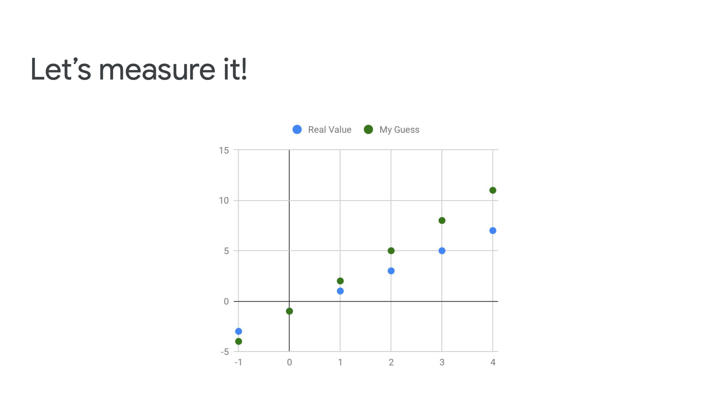

Slide 22
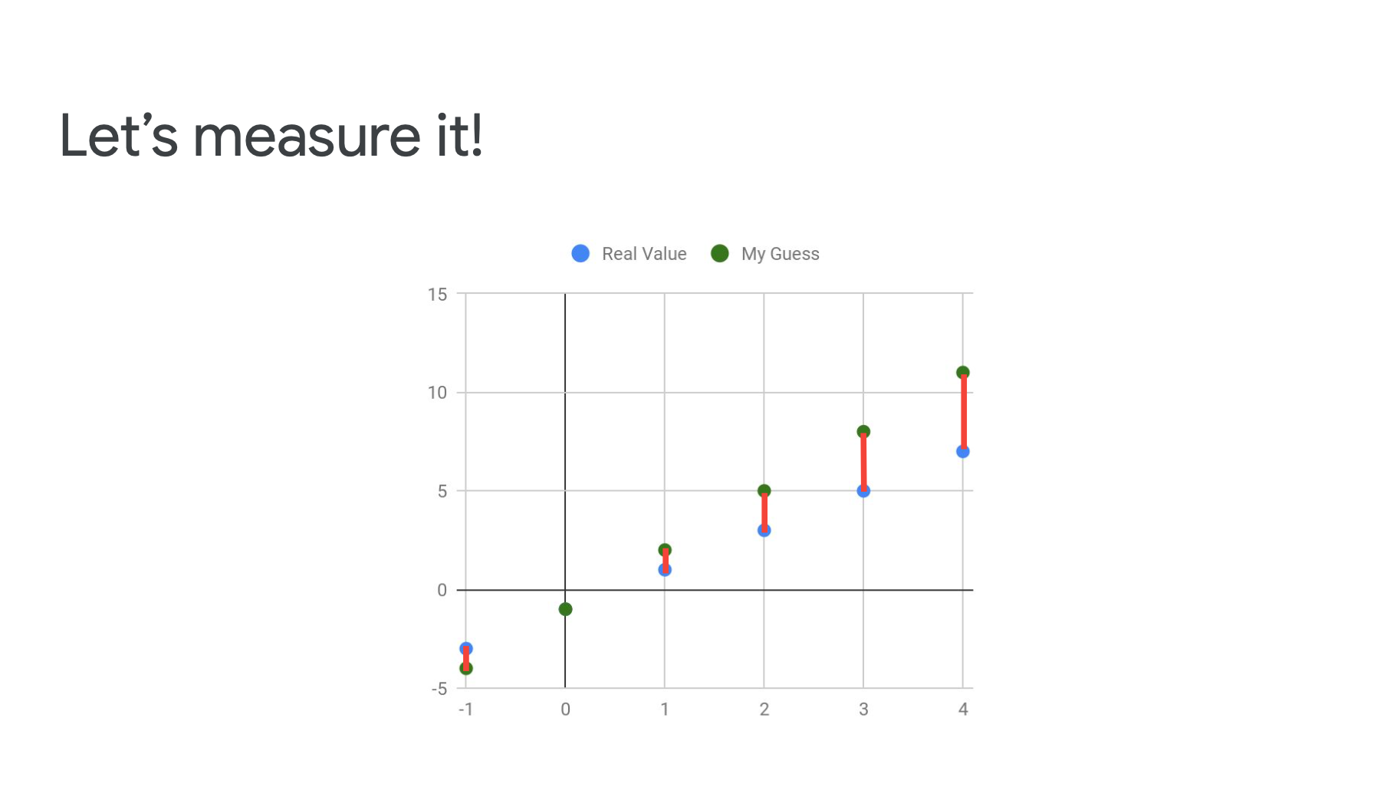

Slide 23
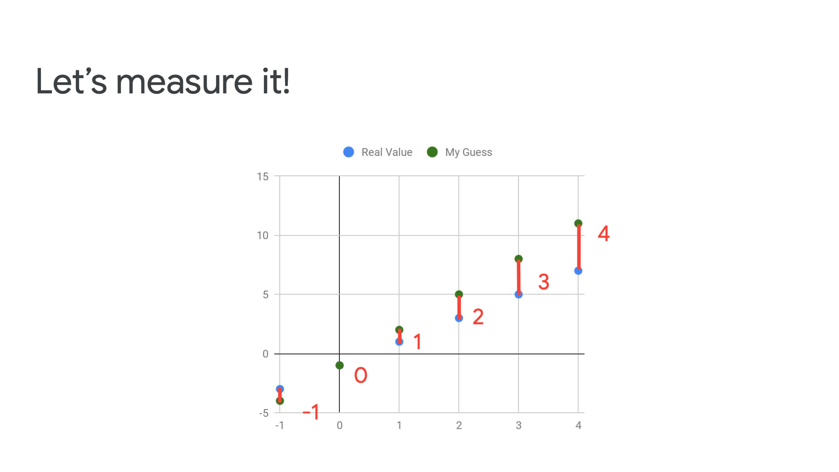

Slide 24
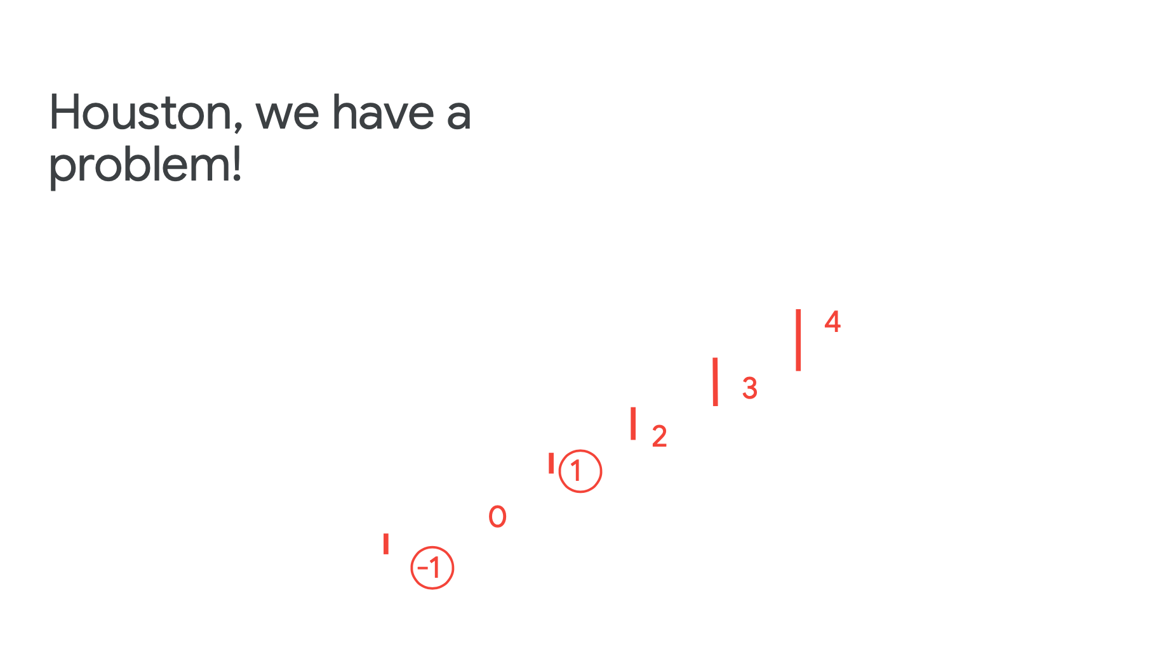
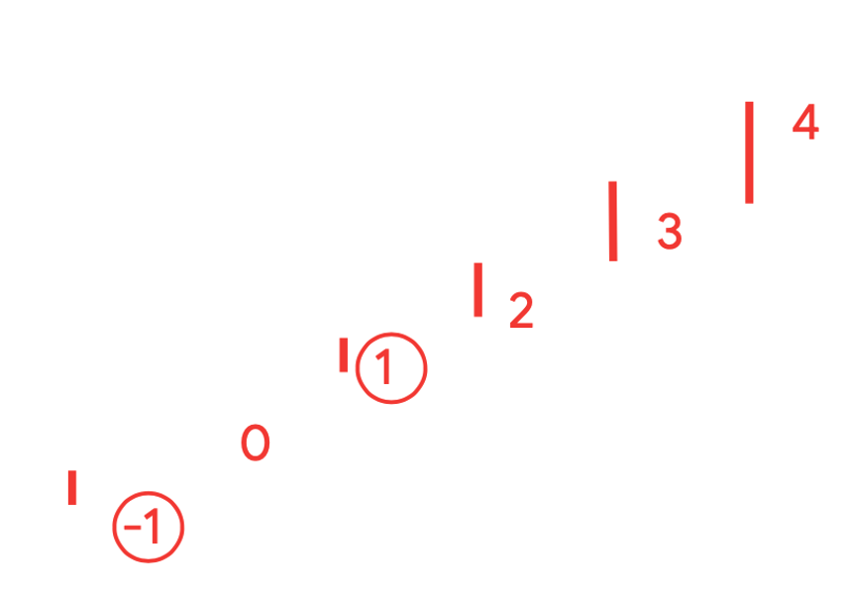

Slide 25
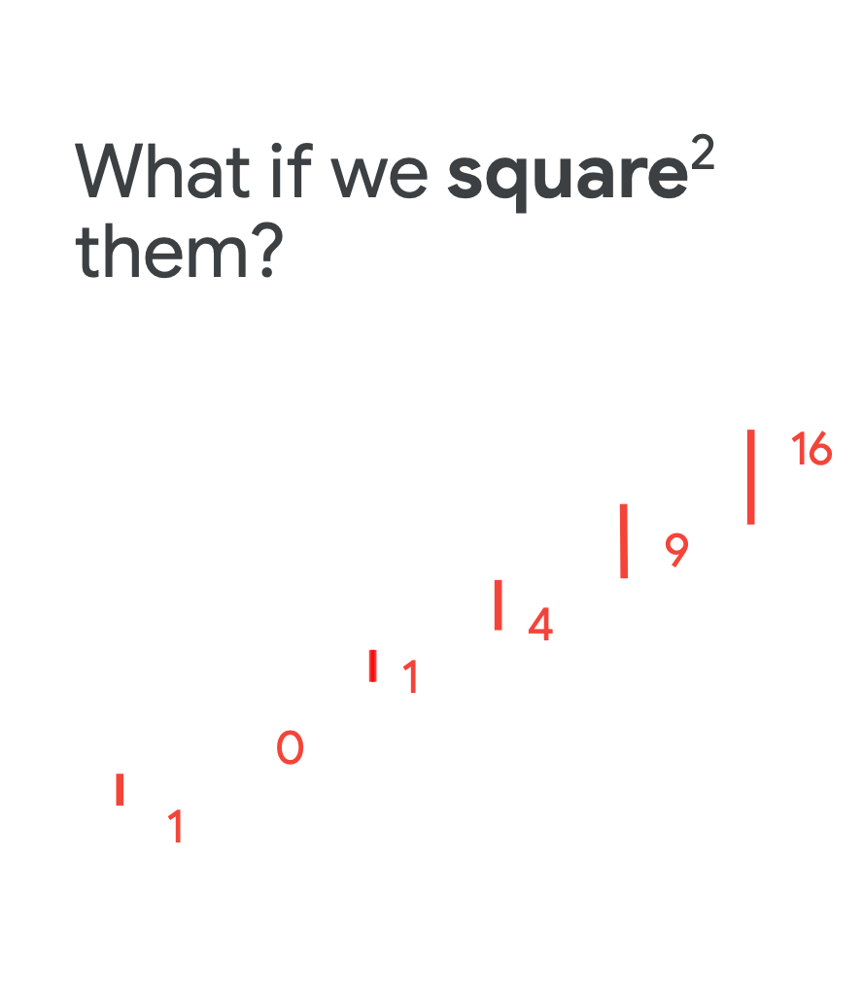

Slide 26


Slide 27
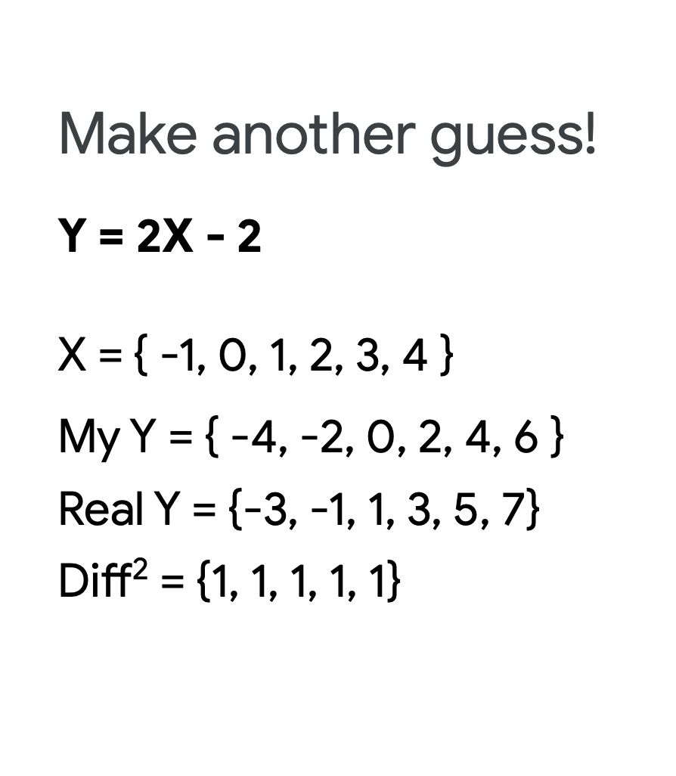
p = +2
b = -2

Slide 28
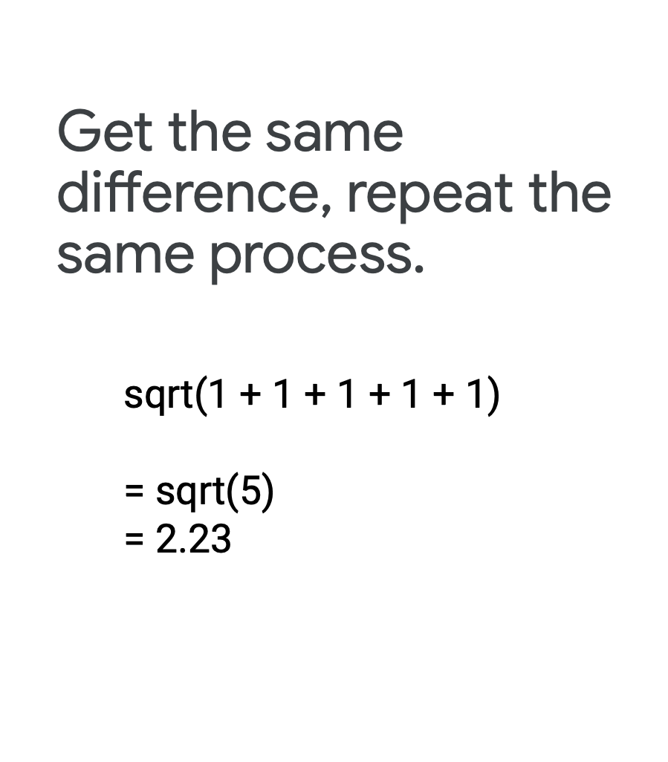

Slide 29
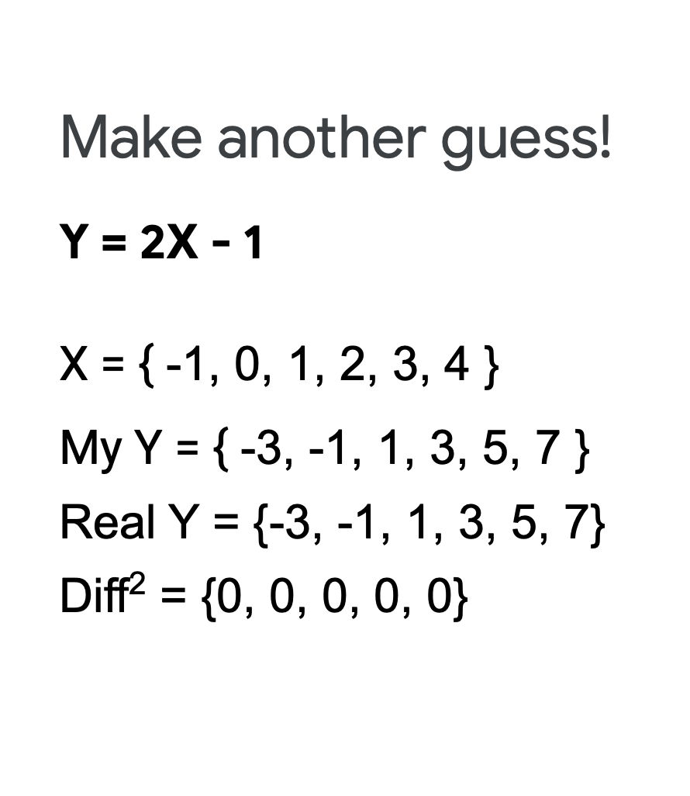

Slide 30
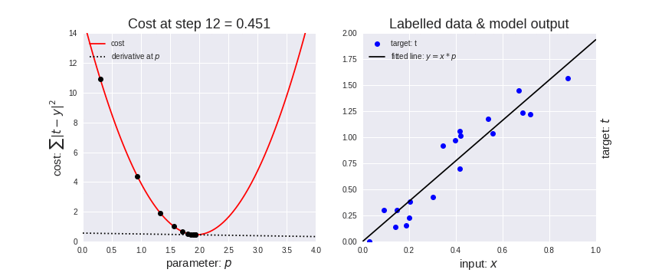
(Real Y)
Parameters
(My Y)
(Real Y)

Slide 31
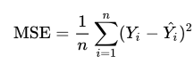
(Real Y)
Parameters
(My Y)
(Real Y)
Mean Squared Error: Goal: Minimum as possible!

Slide 32
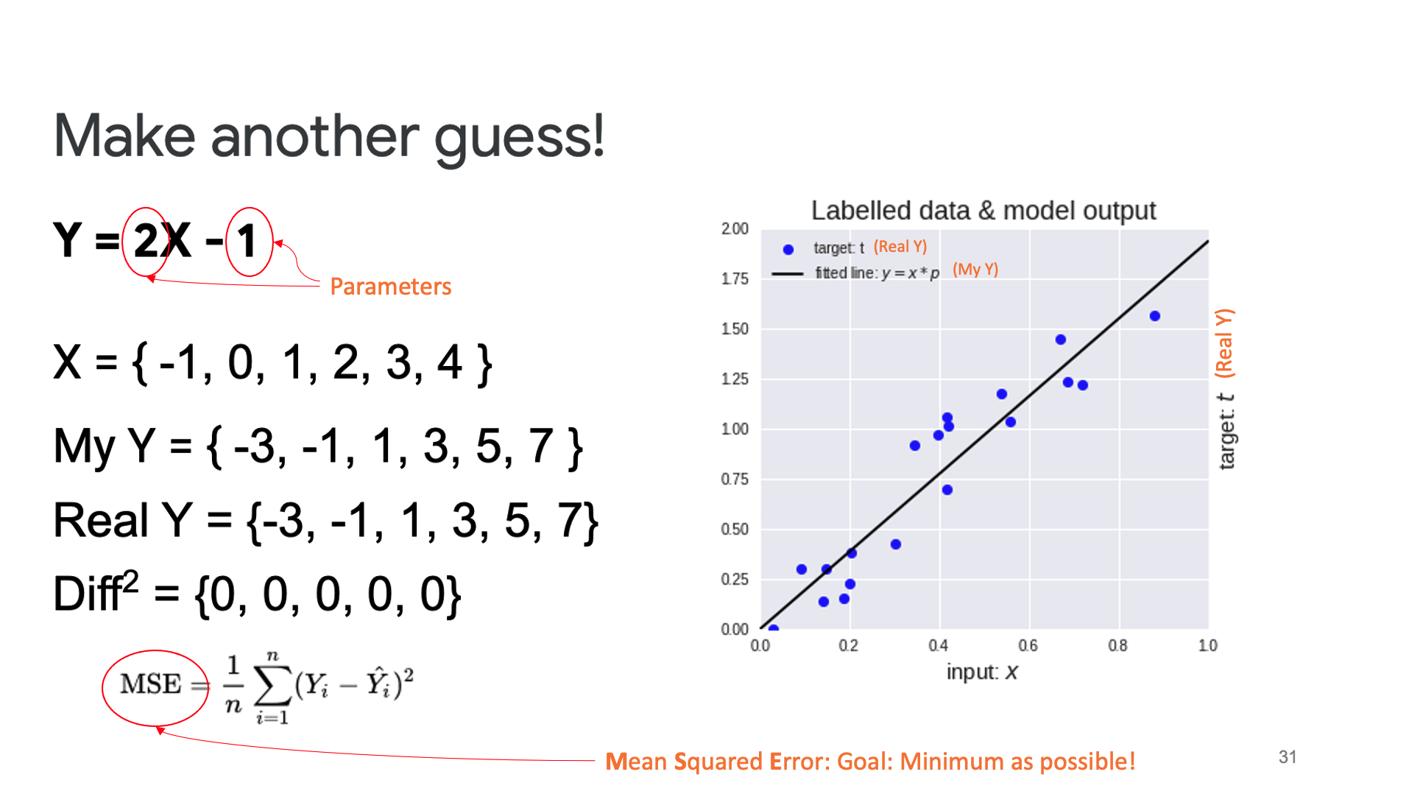

Slide 33


Exploring Loss and Cost Function Code Time!

Slide 34
Minimizing loss… Moving down the curve…

Slide 35
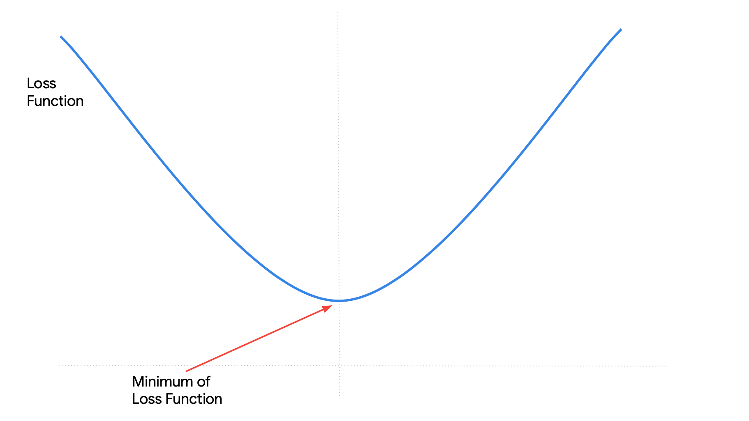
Loss (or Cost) Function
Y = w.x
Loss (or Cost) Function quantifies the error between predicted values (ŷ) and expected values (y)
w

Slide 36
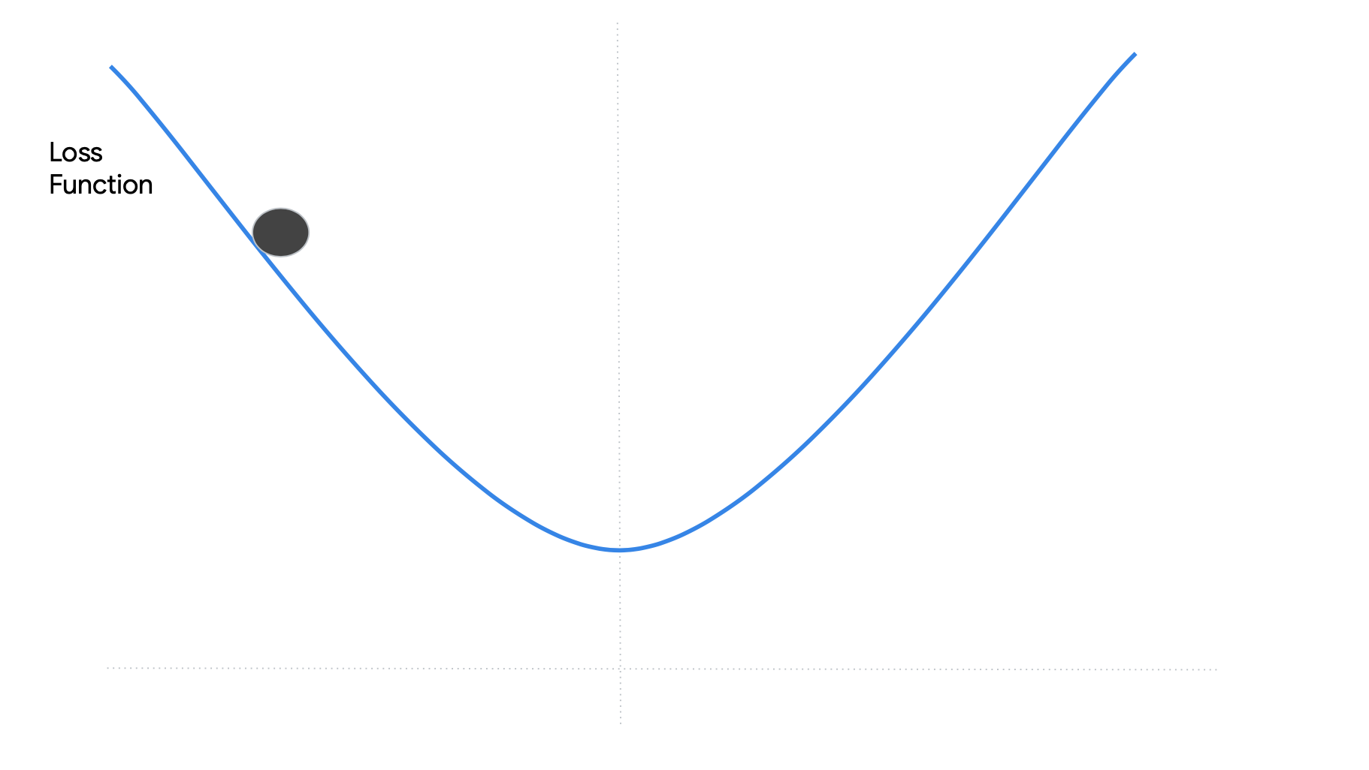
Starting point
w₀
w

Slide 37
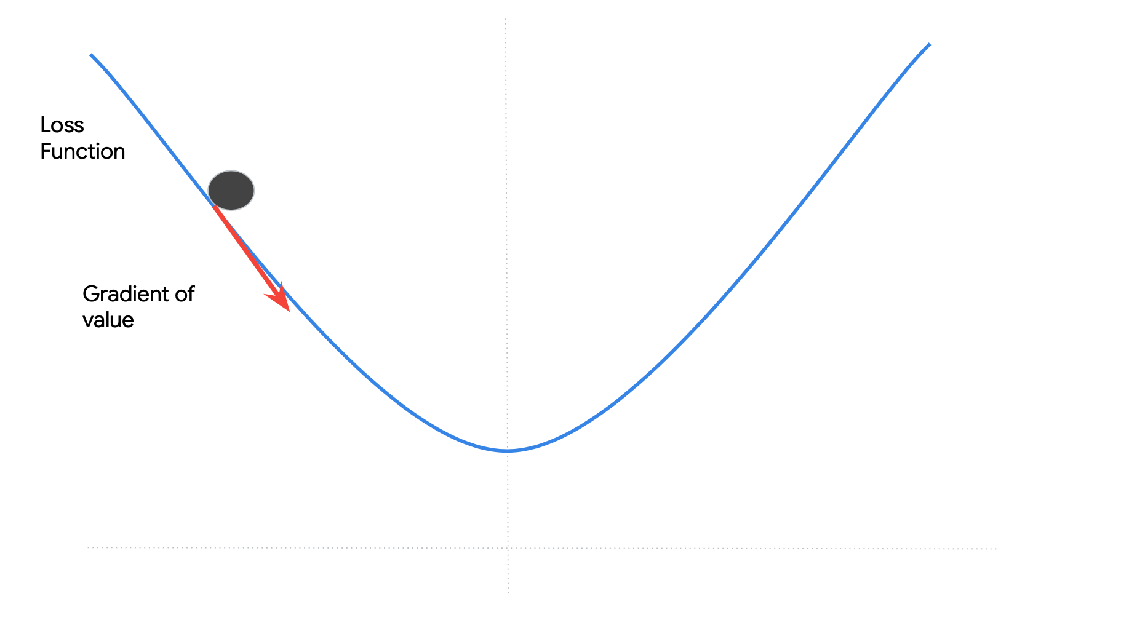
Goal: To minime our loss function by moving in a direction indicated of the gradient
w₀
w

Slide 38
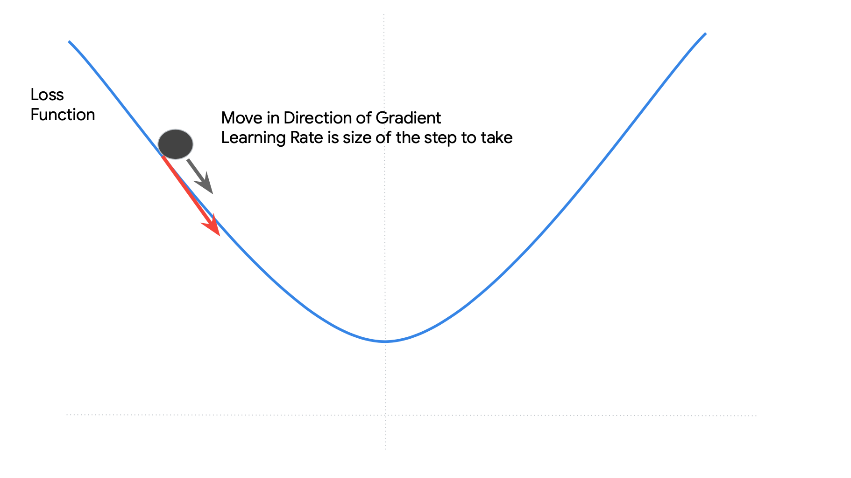
w₁ = w_{o} – alpha(dLoss)
dw
alpha ➔ Learning Rate
dLoss ➔ Gradiente
dw
w₀
w

Slide 39
Starting point
Ending point
Iteration,
Step or,
epoch
w₁ = w_{o} – alpha(dLoss)
dw
w₀
w₁
w

Slide 40
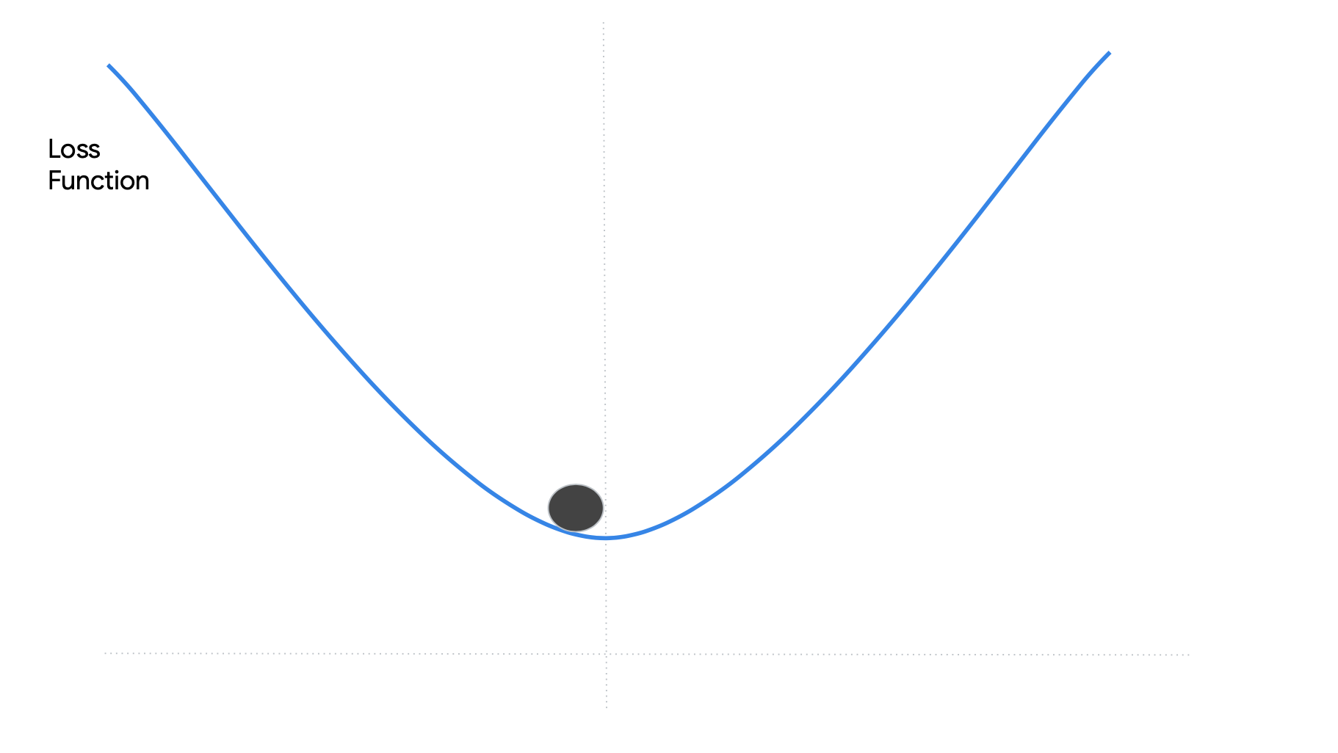
Step 1
Step 2

Slide 41
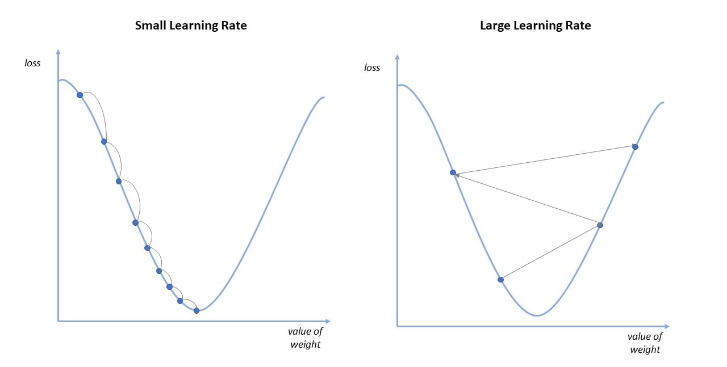
It is important to choose the correct Learning Rate (size of the step)
If the Learning Rate is too small it may take a long time to reach the minimum
If the Learning Rate is too large we may never reach the minimum

Slide 42
Gradient Descent algorithm

Slide 43
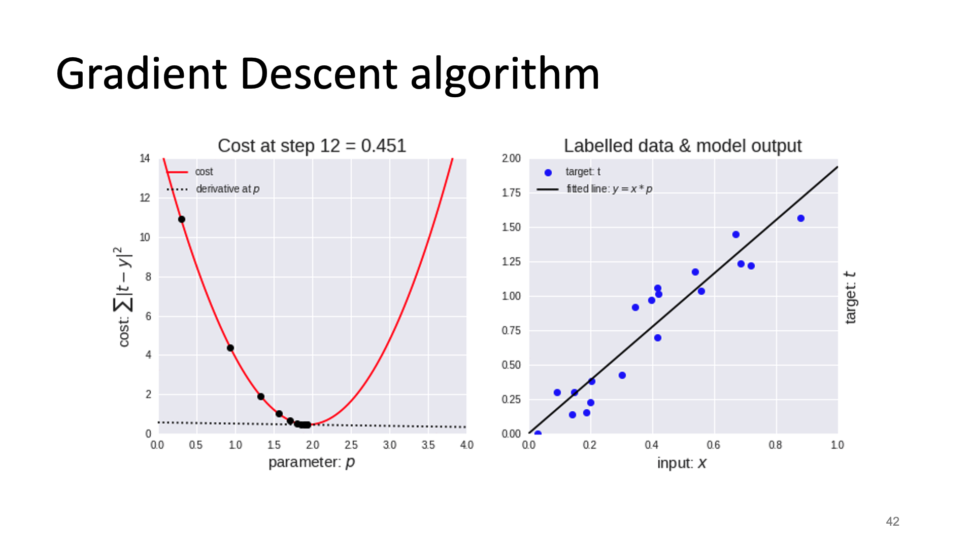

Slide 45
W_{i} , b_{i}
MSE
SGD
(Weights)
(Loss, Accuracy)
(Learning-rate)
Epochs
(Back-Propagation)

Slide 46
Reading Material

Slide 47
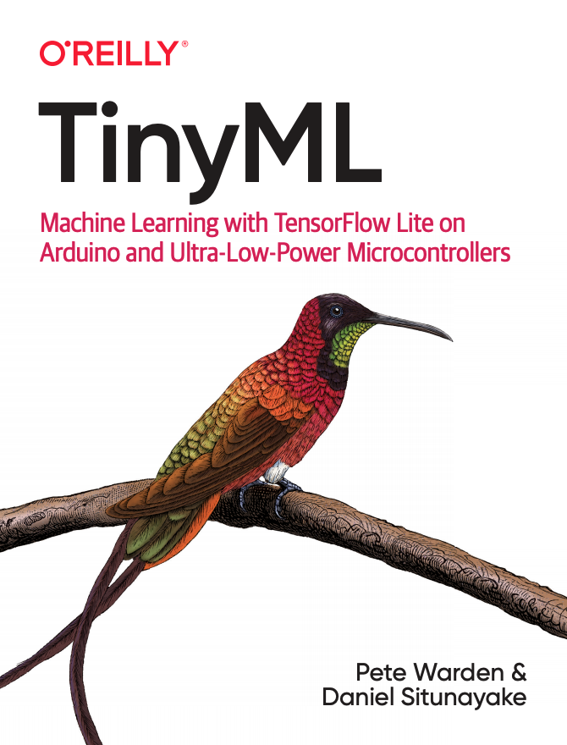
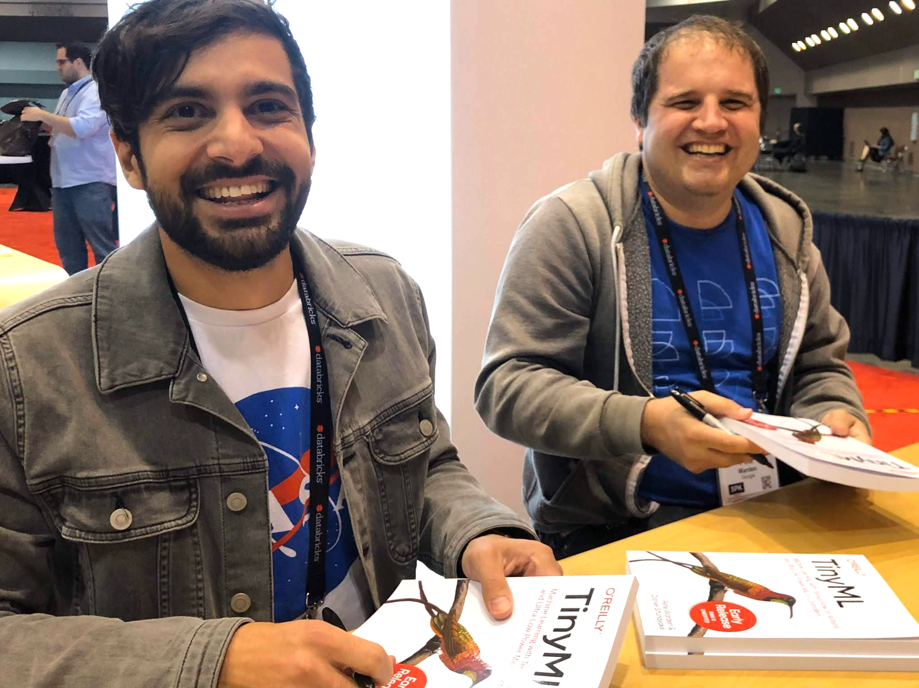
Special IESTI01 Class with Daniel Situnayake,
ML R&D Lead at Edge Impulse, guest Lecturer at Harvard and Berkeley Universities. Ex-GoogleAI and Co-author of TinyML.
Reserve in your calendar: July 14th at 4:30pm (Brasilia Time)

Slide 48
Main references
Harvard School of Engineering and Applied Sciences - CS249r: Tiny Machine Learning
Professional Certificate in Tiny Machine Learning (TinyML) – edX/Harvard
Introduction to Embedded Machine Learning (Coursera)
Text Book: "TinyML" by Pete Warden, Daniel Situnayake
I want to thank Laurence Moroney from Google, Harvard professor Vijay Janapa Reddi, Ph.D. student Brian Plancher and their staff for preparing the excellent material on TinyML that is the basis of this course at UNIFEI.
The IESTI01 course is part of the TinyML4D, an initiative to make TinyML education available to everyone globally.

Slide 49
Thanks
And stay safe!

